Slide 1
Craft Luminaries of Kentucky
Exhibit sponsored by the Kentucky Craft History & Education Association
Photos by jeffrogers.com

Slide 2
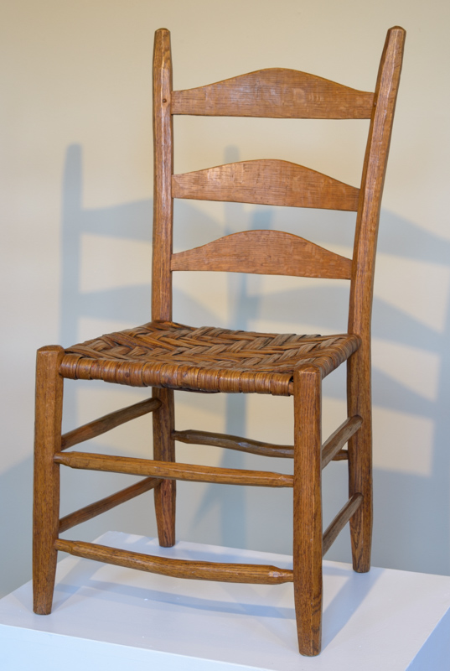
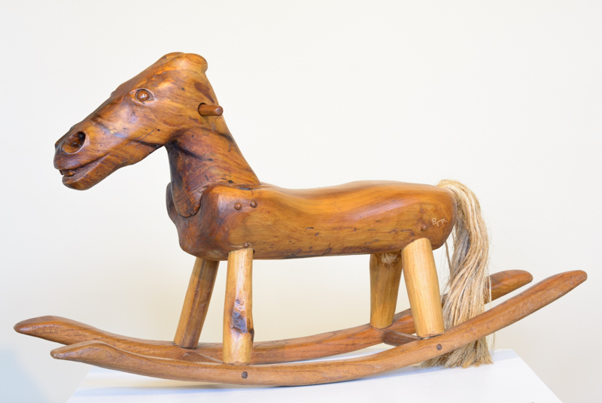
Hobby Horse and Dining Chair by Terry Ratliff
Woodworker
Martin, Kentucky
Tulip Poplar and Oak
38” long x 10” wide x 20” high
Oak and hickory bark
19” wide x 17” long x 38” high

Slide 3
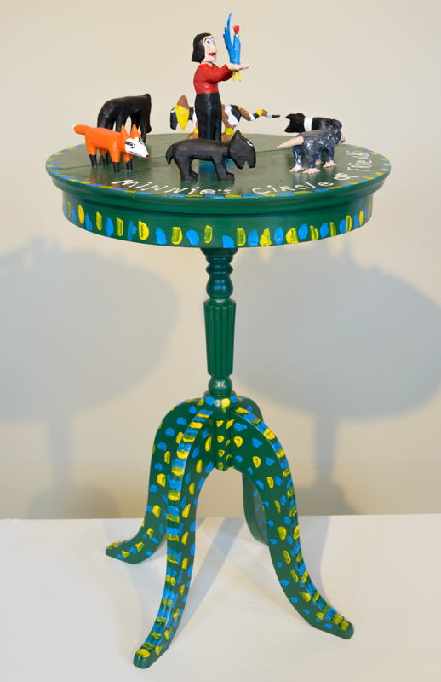
Circle of Friends by Minnie Adkins
Folk Artist
Isonville, Kentucky
Carved Wooden Table featuring several of Adkins’ carved animals.
Acrylics on Wood
17” diameter x 27” high

Slide 4
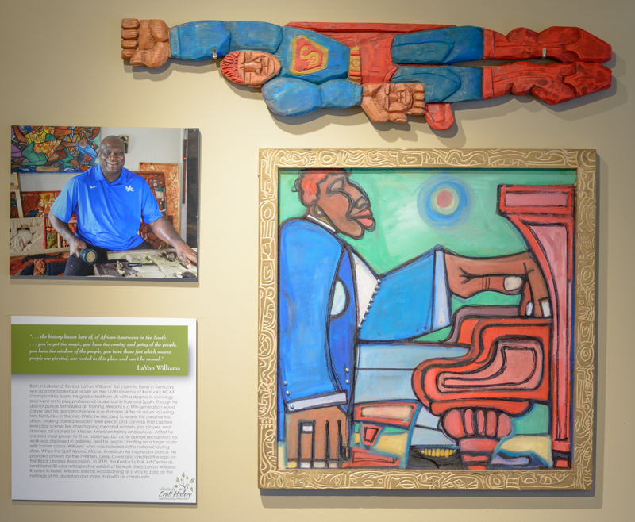
Relief Wood Carving and Painting by Lavon Williams
Carver
Lexington, Kentucky
Superman
Oil on wood
11” wide x 53” long x 4” high
Poor Boy
Painting on carved frame
35.5” wide x 36” long x 2” high

Slide 5
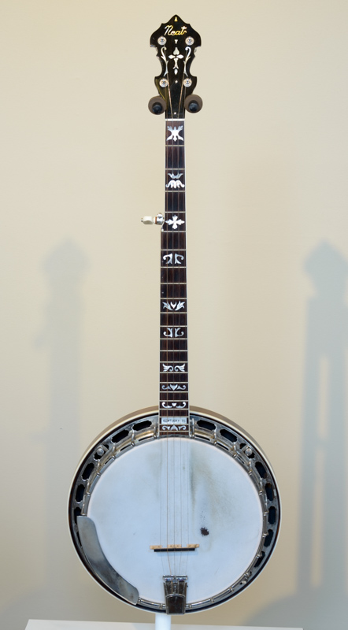
Banjo by Frank Neat
Luthier
Russell Springs, Kentucky
Wood instrument
13” wide x 38”long x 4”high

Slide 6
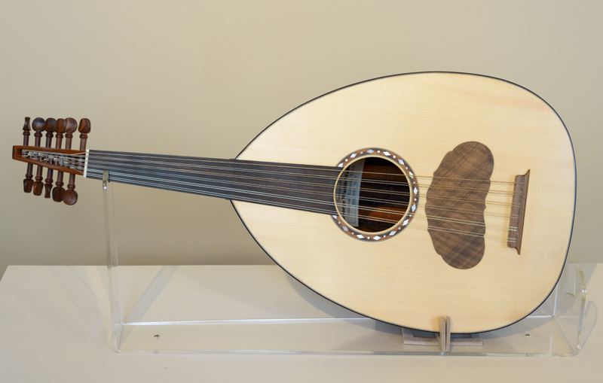
Wooden Oud by George Wakim
Luthier
Lexington, Kentucky
Traditional instrument
15” wide x 31” long x 15”
x 7” high

Slide 7
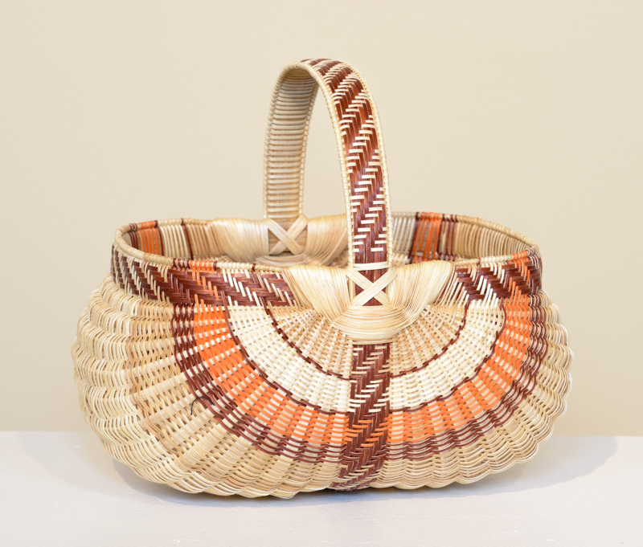
White Oak Egg Basket by Leona Waddell
Basketmaker
Cecilia, Kentucky
Split White Oak
12”wide x 9”long x 11”high

Slide 8
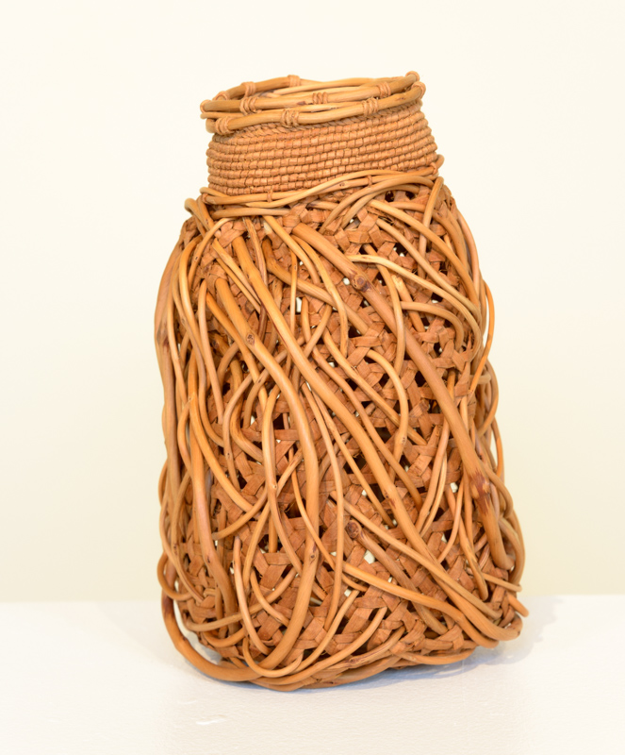
Entwined # 1 by Jennifer Zurick
Basketmaker
Berea, Kentucky
Willow bark basket
6” wide x 6” long x 10” high

Slide 9
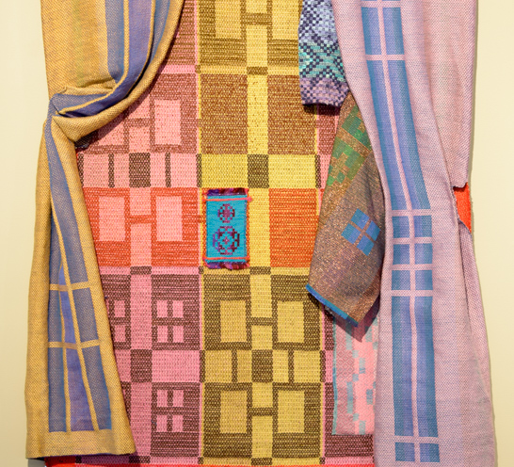
City Windows by Philis Alvic
Weaver
Lexington, Kentucky
Fiber art
41” Wide x 65” long

Slide 10
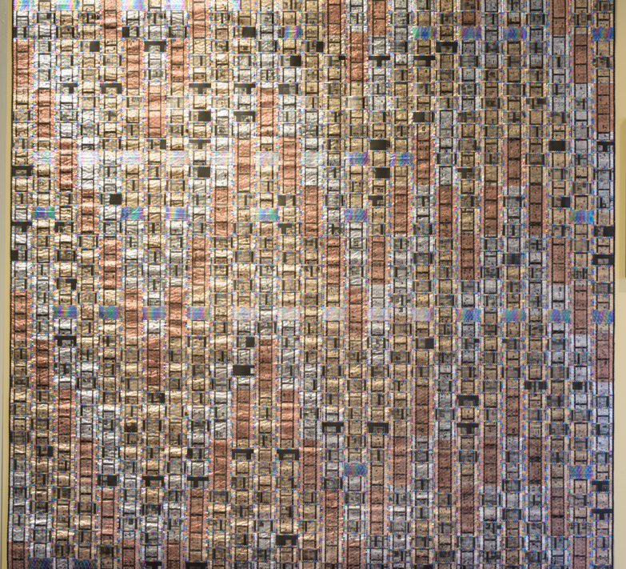
Pattern Fusion No. 1, 2004 by Arturo Alonzo Sandoval,
Weaver
Lexington, Kentucky
60.5” x 60.5”, machine stitched and interlaced; recycled auto industry Mylar, recycled library 35 mm microfilm, netting, monofilament and multi-colored threads, plaited braid, Pellon, polymer medium, fabric backed.

Slide 11
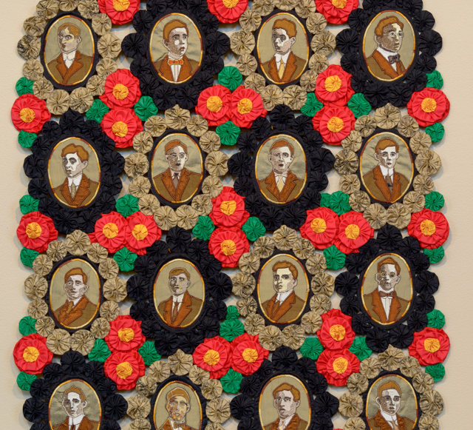
The Real Cost of War: THE CLASS OF 1912 by Rebekka Seigel
Quilter
Owenton, Kentucky
20” wide x 31” long
Hand-stitched yo-yo quilt
Portraits scanned and printed on silk

Slide 12
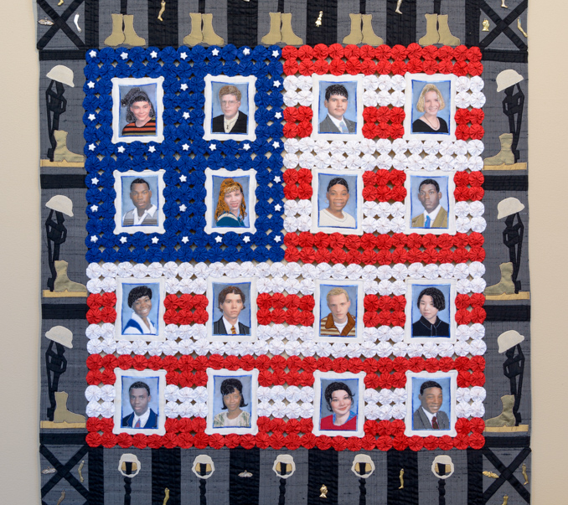
The Real Cost of War: THE CLASS OF 2002 by Rebekka Seigel
Quilter
Owenton, Kentucky
32”wide x 41” long
Hand-stitched yo-yo quilt
Portraits scanned and printed on silk

Slide 13
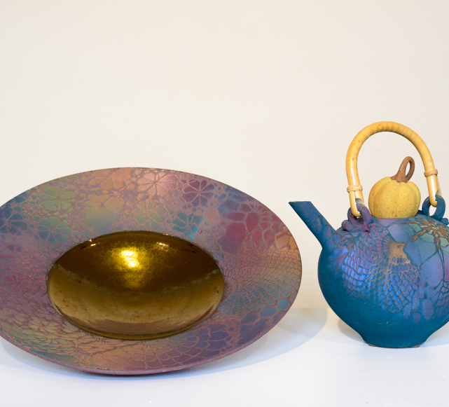
Ceramic Bowl and Teapot by Sarah Frederick
Potter
Louisville, Kentucky
Large Bowl
Clay
17” diameter x 3.5 h
Ceramic Teapot
Clay
10”long x 7”wide x 12” high

Slide 14
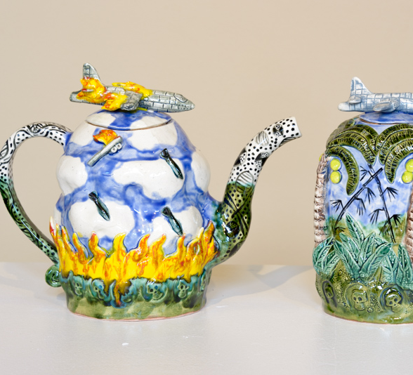
Jar and Teapot from Vietnam Series by Wayne Ferguson
Potter
Louisville, Kentucky
Operation Rolling
Thunder Mayday
(Tea Pot)
Clay
9” wide x 10.5” long
Spooky (Rice Jar)
Clay
5” wide x 8” high

Slide 15
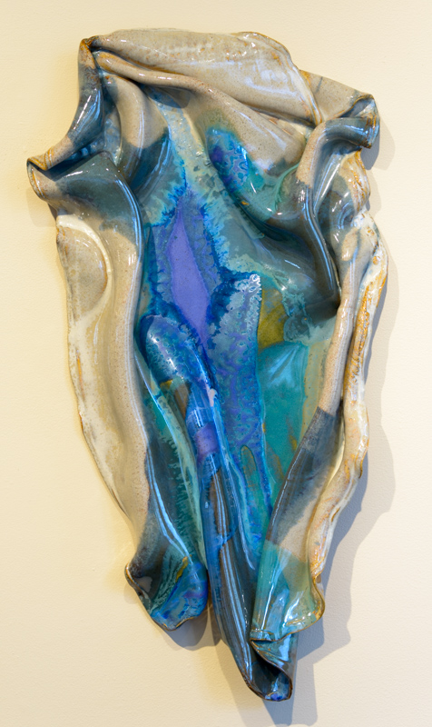
Ceramic Wall Hanging by Susan Goldstein
Potter
Lexington, Kentucky
Rivers of Colors
Clay/Stoneware
16” wide x 30” long x 3” high

Slide 16
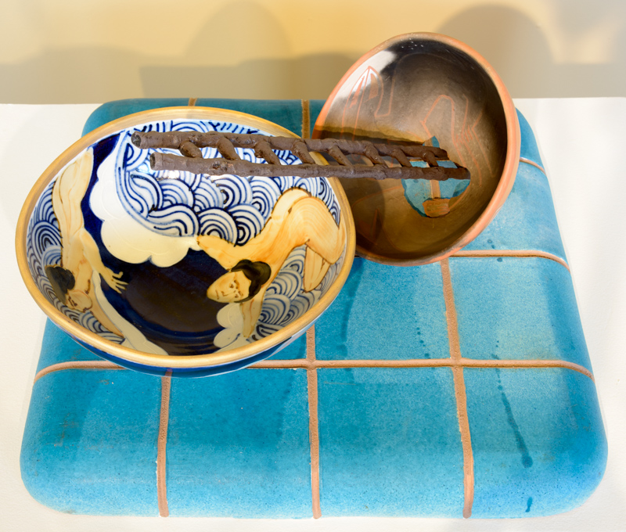
Ceramic Vignette by Walter Hyleck
Potter
Berea, Kentucky
The Swimmer Learns to Drown in Spite of Her Fear of Water
Ceramic
18”wide x 18”long x 11” high

Slide 17
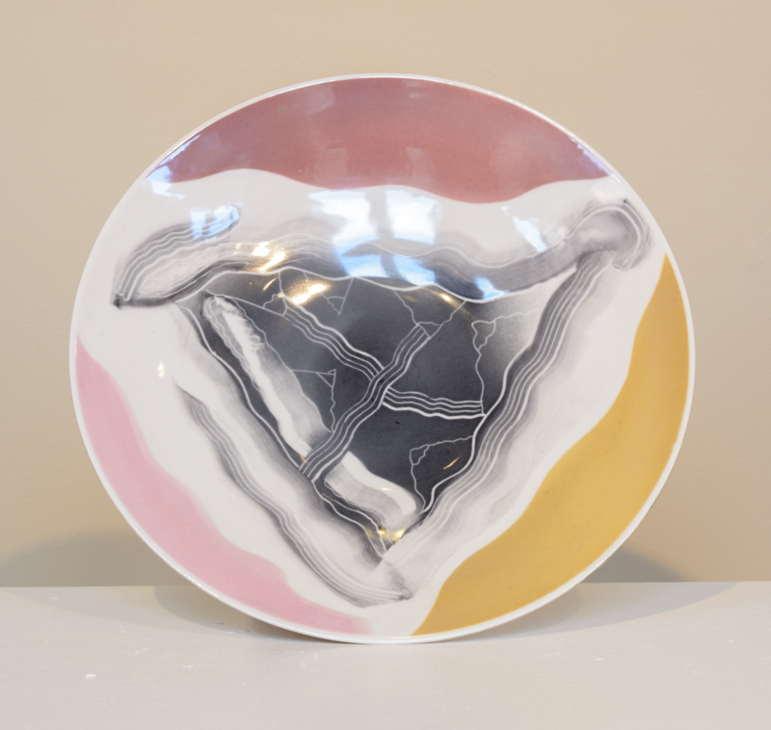
Porcelain Bowl by Fred Shepard
Potter
Murray, Kentucky
The Intersection of Triangles #4
Porcelain bowl
13.5” diameter

Slide 18
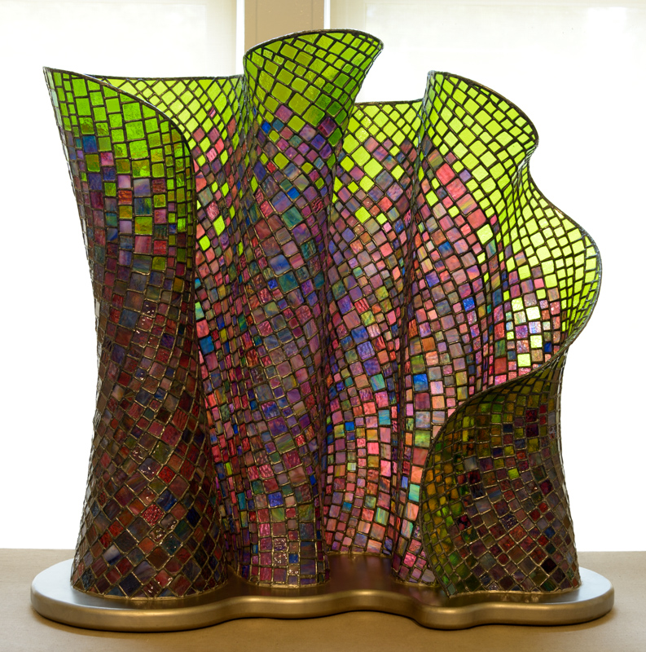
Glass Sculpture
By Dan Neil Barnes
Glass Artist
Lexington, Kentucky
Vibrant
Glass
40” long x 18” wide x 39” high

Slide 19
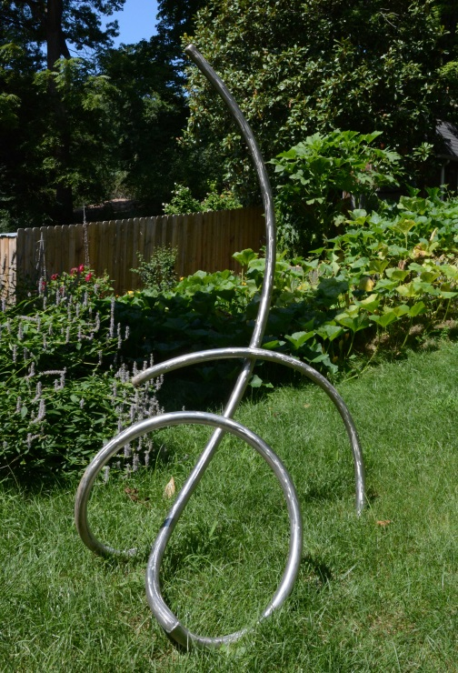
Morphed by Dave Caudill
Metal Sculptor
Louisville, Kentucky
Stainless Steel.
68” long x 50” wide x 84” high

Slide 20
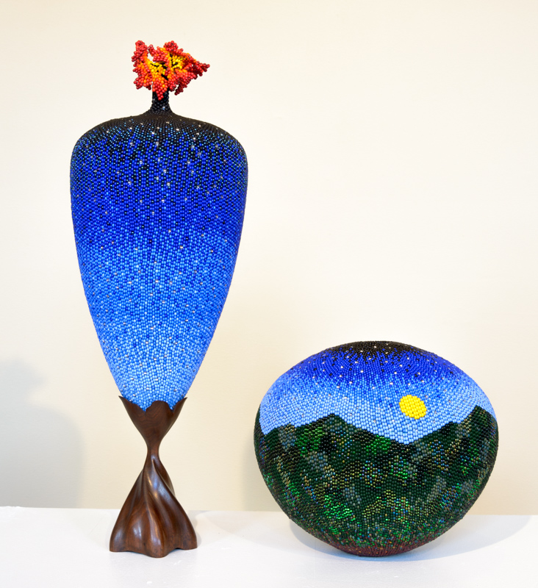
Mixed Media by Linda Fifield
Bead Artist
McKee, Kentucky
Celestial Flower
9” long x 9” wide x 23” high
Hills of Home #32
12” diameter X 10” high
Stitched beadwork over hollow, turned wooden vessel

Slide 21
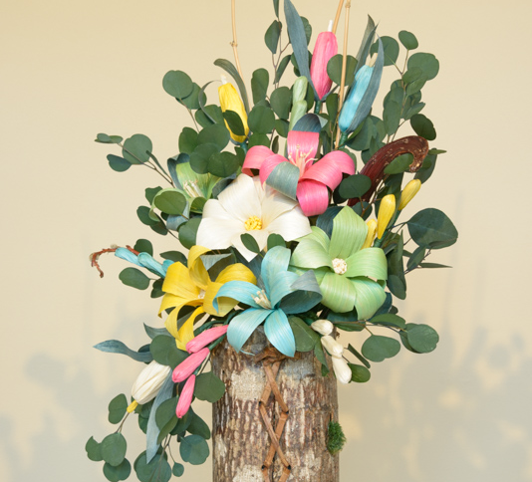
Bark Basket and
Corn Shuck Flowers by Mary & Robin Reed
Mixed Media
Irvine, Kentucky
Mixed Media
11” wide x 9” diameter x 29” h

Slide 22
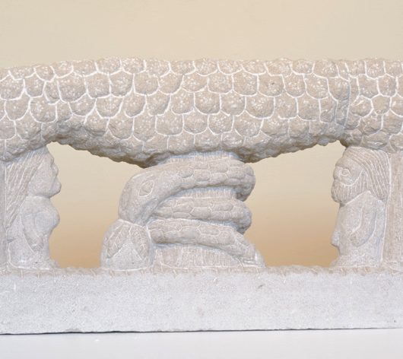
Adam and Eve by Tim Lewis
Stone Carver
Isonville, Kentucky
Carved stone
28” long x 4” wide x 15” high

